Slide 1
Esophageal Adenocarcinoma
After Bariatric Surgery
Giovanni Camerini
U.O.C. di Clinica Chirurgica 2
IRCCS Policlinico San Martino
Università degli Studi di Genova

Slide 2
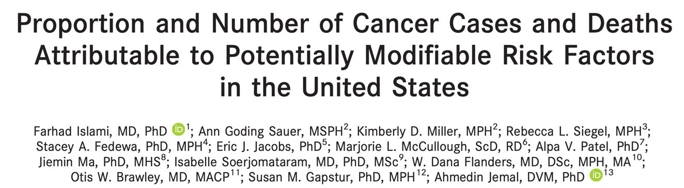
Obesity and overweight are the most important preventable risk factors for cancer after cigarette smoking
Excess body weight is associated with 7.8% of cancer cases and 6.5% of cancer deaths

Slide 3
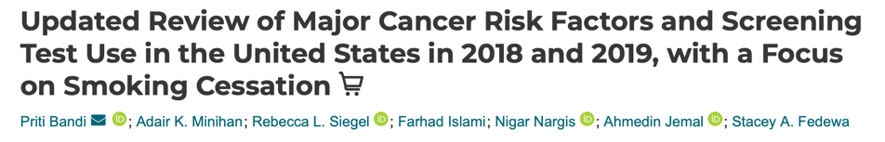
More than 1 billion people in the world are now obese
In total, of an estimated 19.3 million new cases of cancer in 2020 worldwide, 1.5 million cases per year might be attributable to overweight and obesity
Cancer Epidemiol Biomarkers Prev. 2021;30(7):1287-1299.

Slide 4
Excess body weight
60% of uterine cancers
one-third of liver cancers
11% of breast cancers
5% of colorectal cancers.

Slide 5

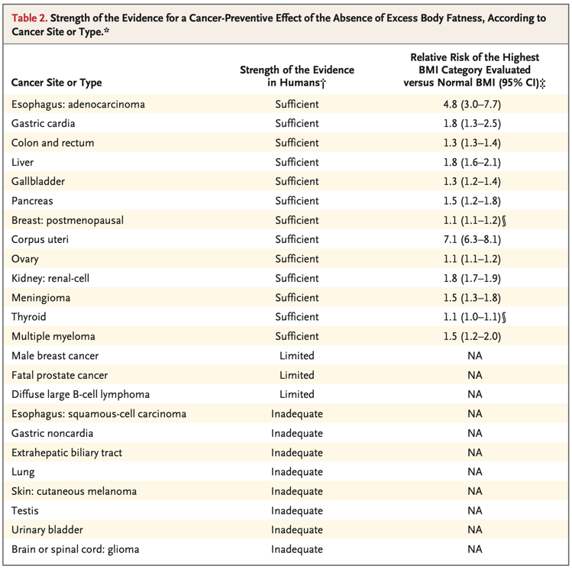

Slide 6
«The heart of the matter»
Incidence of EAC in general population
Incidence of EAC in obese population
Incidence of EAC post BS
Graham Greene, 1948

Slide 7
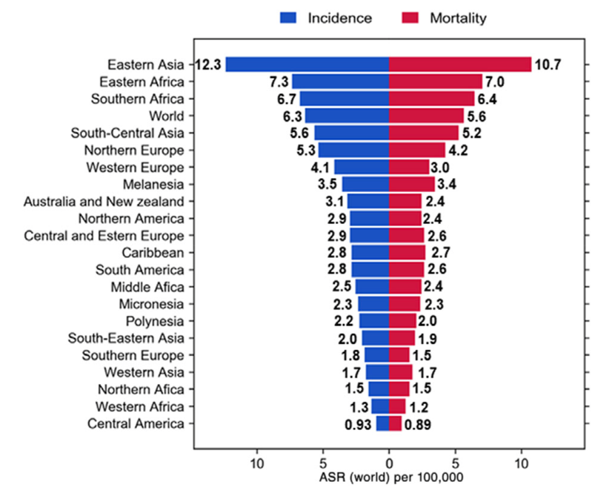
Region-specific incidence and mortality age-standardized rates (ASR) for esophageal cancer worldwide in 2020
Incidence: 2,9-12,3%
GLOBOCAN 2020 (International Agency for Research on Cancer)
Esophageal cancer burden, American Cancer Society (ACS)

Slide 8
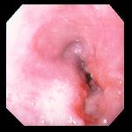
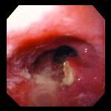
Epidemiology in Europe and U.S.A.
By the early 1990s, adenocarcinoma had become the most common cancerous cell type among white Americans, accounting for approximately one half of esophageal malignancies in the United States and Europe. Currently ¾ of tumors are adenocarcinoma. Squamous cell cancers still predominate In the highest-risk region, the so-called oesophageal cancer belt, (northern Iran, Central Asia, north- central China).

Slide 9
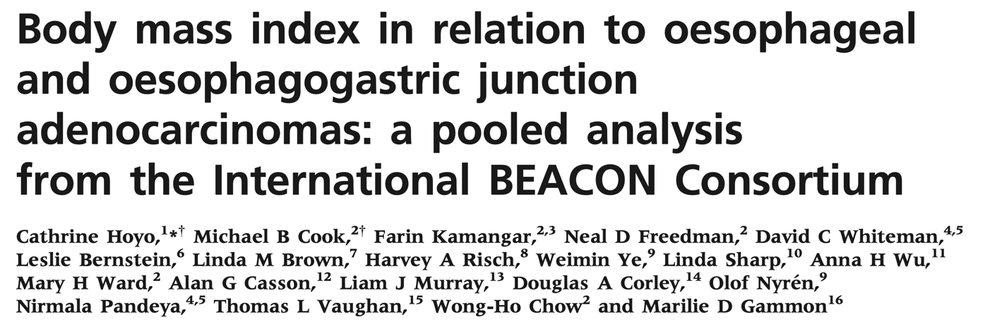
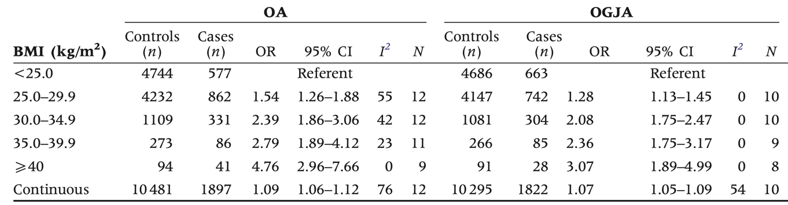
12 epidemiological studies (8 North American, 3 European and 1 Australian)
1997 OA cases
1900 OGJA cases
11 159 control subjects
vs. BMI < 25 kg/m2
OR = 4.76 [95% CI: 2.96–7.66] for class III obesity [BMI ≥ 40 kg/m2 ]
OR = 2.79 [95% CI: 1.89–4.12] for class II obesity [BMI: 35– 39.9 kg/m2]
OR = 2.39 [95% CI: 1.86–3.06] for class I obesity [BMI: 30–34.9 kg/m2]
OR = 1.54 [95% CI: 1.26–1.88] for overweight [BMI: 25–29.9 kg/m2 ]

Slide 10
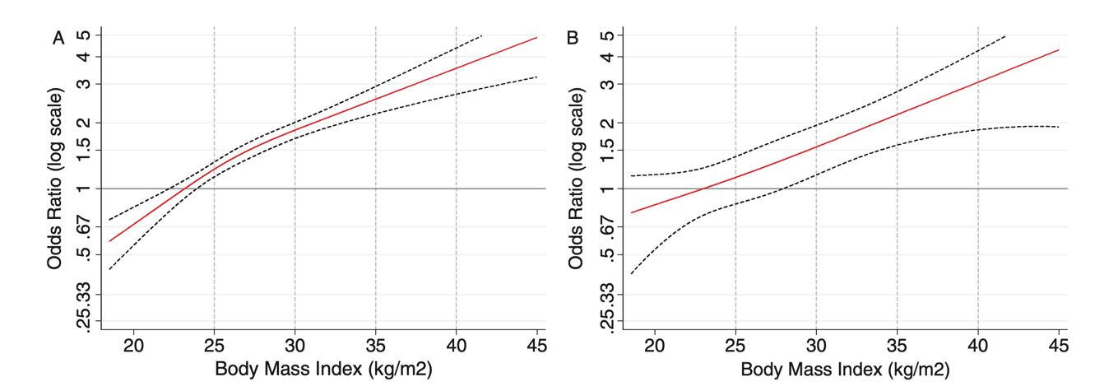

Slide 11
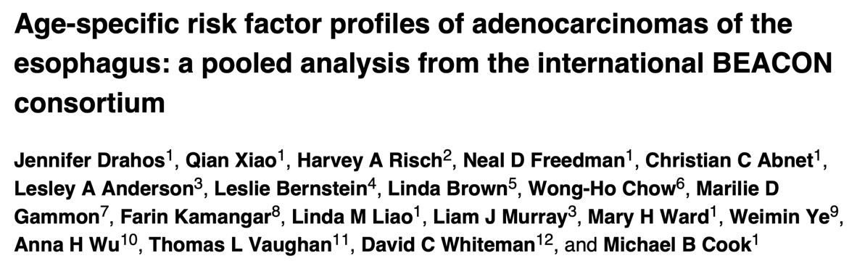
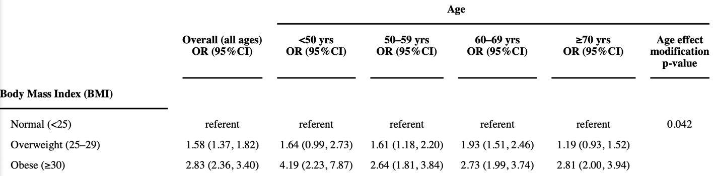

Slide 12
Incidence of EC after obesity surgery
GERD
  Barrett esophagus 10% after SG (4.8%-18.8%).
  Risk of evolution of Barrett 0.3% and 0.5%.
  BILE REFLUX
    OAGBP
    Excluded stomach
BMI reduction reduction
  Fluctuations of estrogen and insulin
  Insulin and IGF signaling.
  Chronic inflammation (adipokines )
  Metabolic aberration
  Dietary factors
  GERD

Slide 14
Gastroesophageal reflux disease and Barrett's esophagus after laparoscopic sleeve gastrectomy: a possible, underestimated long-term complication.
Genco A Surg Obes Relat Dis. 2017 Apr;13(4):568-574.

Slide 15
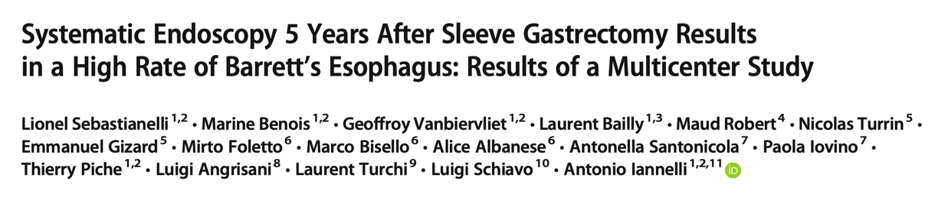
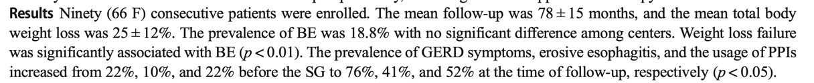

Ninety (66 F) consecutive patients
No evidence of BE preoperatively
Mean follow-up was 78 ± 15 months
Mean total body weight loss was 25 ± 12%

Slide 16
Clinical Issues Committee of the American Society for Metabolic and Bariatric Surgery. ASMBS position statement on the rationale for performance of upper gastrointestinal endoscopy before and after metabolic and bariatric surgery
Sleeve Gastrectomy
De novo Barrett 18%
Nondysplastic
Short segment (<3 cm)
Campos GM, Surg Obes Relat Dis. 2021;17(5):837-847.

Slide 17
Esophageal adenocarcinoma after obesity surgery in a population-based cohort study
Both groups had a high risk of cancer
Results
Among 34,437 study participants undergoing obesity surgery and 239,775 person-years of follow-up, 8 cases of EAC occurred (SIR 1.6; 95% CI .7–3.2). No clear trend of decreased SIRs was observed in relation to increased follow-up time after surgery. The SIR of EACs (n = 53) among 123,695 obese individuals who did not undergo obesity surgery (673,238 person-years) was increased to a similar extent as in the obesity surgery cohort (SIR = 1.9, 95% CI 1.4–2.5). Cox regression demonstrated no difference in risk of EAC between participants who underwent obesity surgery and those who did not (adjusted hazard ratio = .9, 95% CI .4–1.9).
John Maret-Ouda, Surg Obes Relat Dis. 2017;13(1):28-34 23
Notes:
Non esistono studi dove viene studiata prospetticamente l'efficacia di un intervento ma solo studi retrospettivi caso-controllo, che valutano il nesso causale tra un outcome già presente al tempo zero e una pregressa esposizione a qualche fattore che si suppone in grado di condizionare l'outcome: l’'Odds è espresso dal rapporto (n. di casi in cui il fenomeno si è verificato) / (n. di casi in cui il fenomeno non si è verificato) e si applica negli

Slide 18
Incidence of GERD, esophagitis, Barrett’s esophagus, and esophageal adenocarcinoma after bariatric surgery
Incidence of 8.1 cases per 100 000 persons per year
Results
A total of 48,967 records were analyzed; 30.3% had a diagnosis of GERD at the time of surgery and .4% had a diagnosis of esophagitis and Barrett’s. Preoperative GERD/esophagitis/Barrett’s was associated with higher risk of GERD, esophagitis, and Barrett’s, but not esophageal adenocarcinoma, postoperatively. Roux-en-Y gastric bypass patients had lowest risk of being diagnosed with GERD postoperatively. Overall, esophageal adenocarcinoma incidence in the sample was .04%; the rate among patients with preoperative GERD and Barrett’s was .1% and .9%, respectively. Incidence of esophageal adenocarcinoma did not differ by bariatric surgery type.
Bevilacqua LA, Surg Obes Relat Dis. 2020;16(11): 1828-1836. 21

Slide 19
Esophageal cancer after sleeve gastrectomy: a population-based comparative cohort study
Incidence, 21 per 100 000 population per year
Results
A total of 4121 patients had reflux-prone procedures and 852 underwent RYGB. At a mean follow-up of 7.6 years, 8 cases of esophageal cancer were identified after bariatric surgery. Compared with RYGB, IRR for esophageal cancer in reflux-prone group was 1.45 (95%CI: .19–65.5) and HR = .83 (95%CI: .10–7.27). The crude incidence rate of esophageal cancer in the reflux-prone group was higher than that of nonsurgical controls (n = 12,159; IRR = 3.46, 95%CI: 1.00–12.5), but after adjustment the difference disappeared (HR = 2.47, 95%CI: .82–7.45).
Andalib A, Surg Obes Relat Dis. 2021;17(5):879- 887. 22

Slide 20
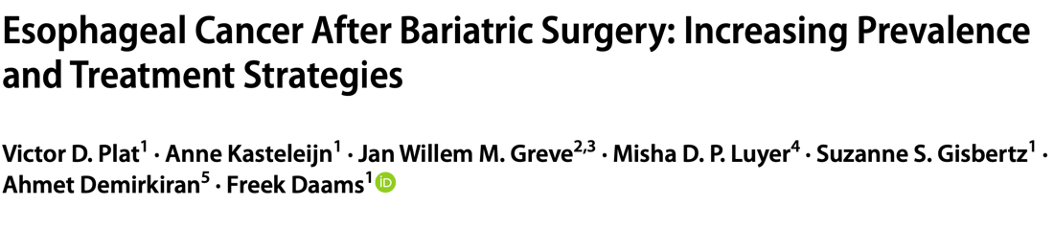
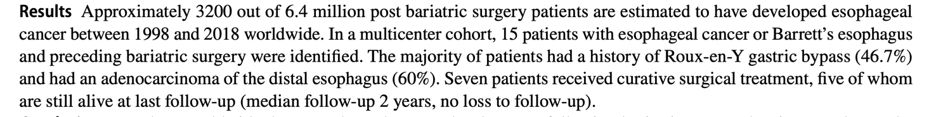
280 000 patients with bariatric surgery
33 new cases of esophageal cancer
Result is consistent with findings from previous cohorts

Slide 21

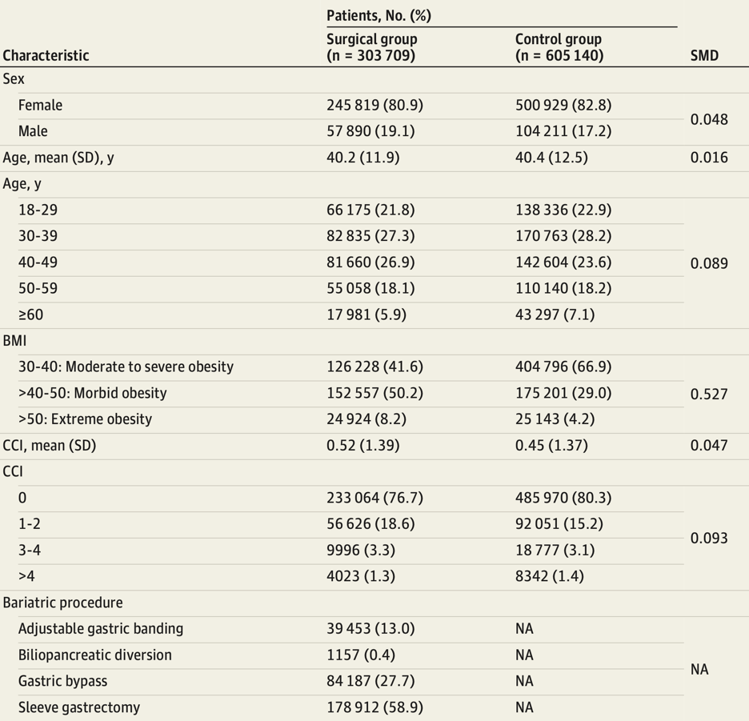
(January 1, 2010 December 31, 2017)
Programme De Médicalisation des Systèmes d’Information (PMSI)

Slide 22
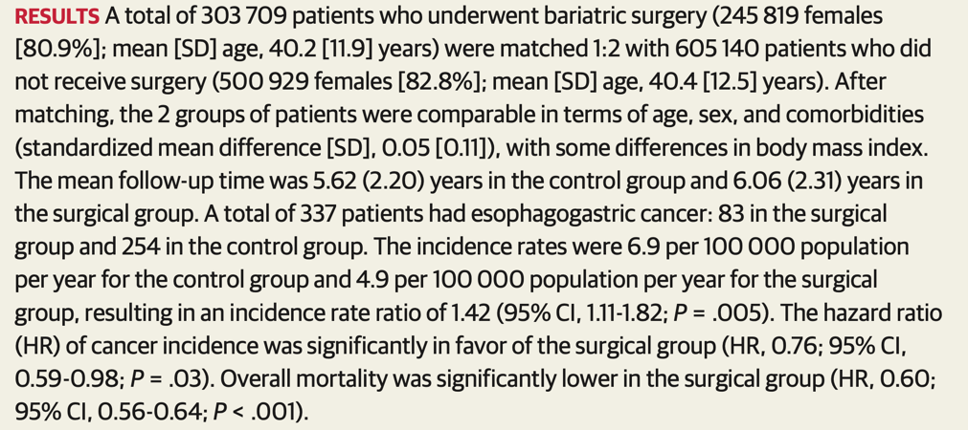

Slide 23
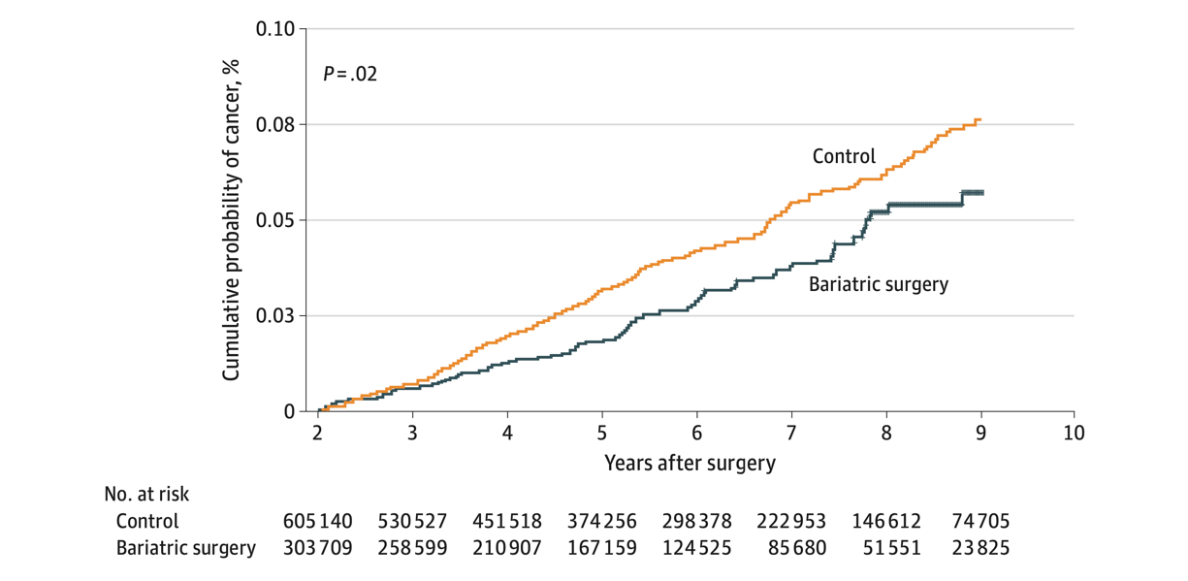
Programme De Médicalisation des Systèmes d’Information (PMSI)
Statistical difference

Slide 24
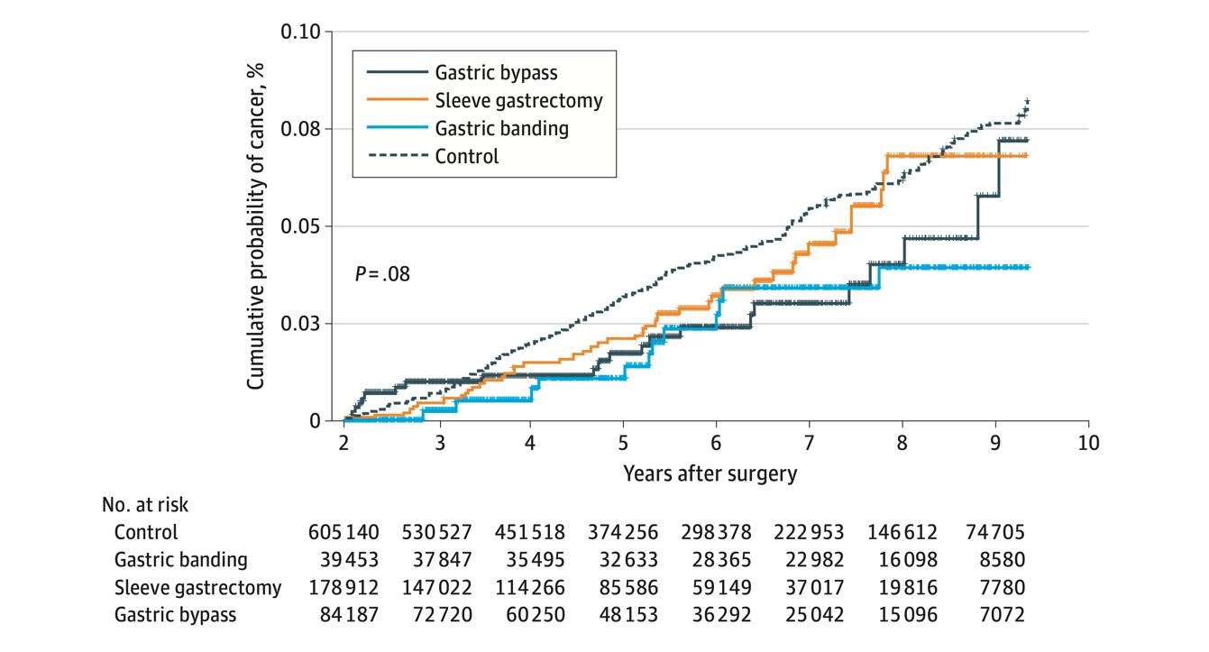
Programme De Médicalisation des Systèmes d’Information (PMSI)
No statistical difference

Slide 25

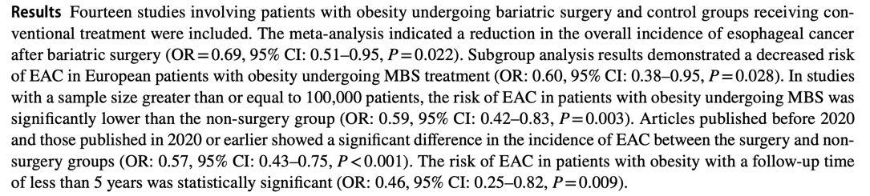
MBS 23.17% (1,081,152)
4,665,963 patients
CT 76.83% (3,584,811)
Reduction in the risk of EAC of 30.7%

Slide 26
Study | Year | Duration of F-U |  | Sample Size |  | Cancer events |  | Risk of EAC
 |  | MS | NMS | MS | NMS | MS | NMS | OR (95% CI) | % weight
Adams | 2009 | 12,3 | 11,8 | 6596 | 9442 | 3 | 5 | 1.07 (0.24 4.80) | 3.39
Maret-Ouda | 2016 | 3,7 | 3,5 | 34.437 | 123.695 | 8 | 53 | 0.54 (0.26 1.14) | 8.06
Mackenzie | 2018 | 55 | 55 | 8794 | 8794 | 4 | 8 | 0.50 (0.15 0.66) | 4.67
Schauer | 2019 | 47 | 41 | 22.198 | 66.427 | 0 | 16 | 0.09 (0.01 1.51) | 1.15
Tao | 2020 | NR | NR | 49.096 | 43.476 | 11 | 260 | 0.37 (0.20 0.68) | 9.53
Tsui | 2020 | NR | NR | 71.000 | 323.197 | 32 | 191 | 0.76 (0.52 1.11) | 12.15
Khalid | 2021 | 5 | 5 | 19.272 | 9636 | 2 | 1 | 1.00 (0.09 11.3) | 1.54
Andalib | 2021 | 7,6 | 7,6 | 4973 | 12.159 | 8 | 6 | 3.26 (1.13 9.41) | 5.51
Aminian | 2022 | 5,8 | 6,1 | 5053 | 25.265 | 2 | 5 | 2.00 (0.39 10.31) | 2.94
Esparham | 2023 | NR | NR | 233.729 | 693.715 | 70 | 189 | 1.10 (0.84 1.45) | 13.2
Lazzati | 2023 | 6,06 | 5,62 | 303.709 | 605.140 | 26 | 86 | 0.60 (0.39 0.93) | 11.42
Desai | 2022 | NR | NR | 174.775 | 524.277 | 10 | 78 | 0.38 (0.20 0.74) | 8.93
Akerstrom | 2023 | 8,1 | 7,4 | 91.731 | 693.799 | 16 | 274 | 0.44 (0.27 2.43) | 10.66
Chittajallu | 2023 | 10 | 10 | 55.789 | 55.789 | 10 | 10 | 1.00 (0.42 2.40) | 6.86

Slide 27
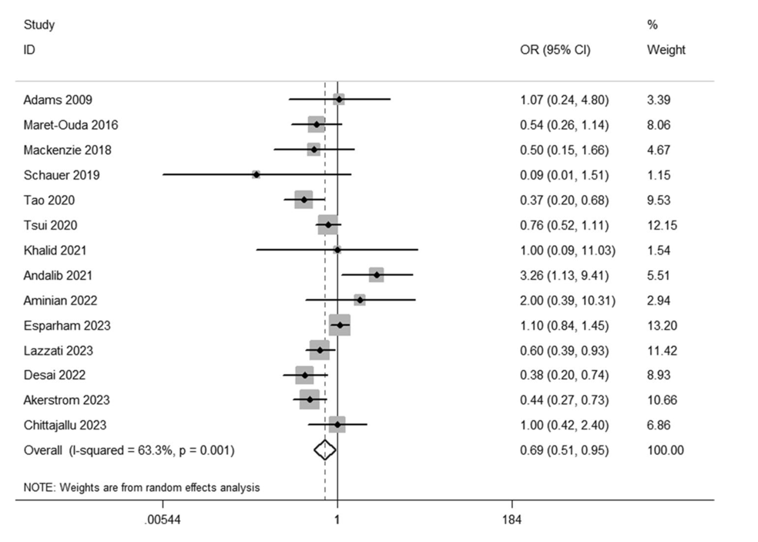
Cumulative Result

Slide 28
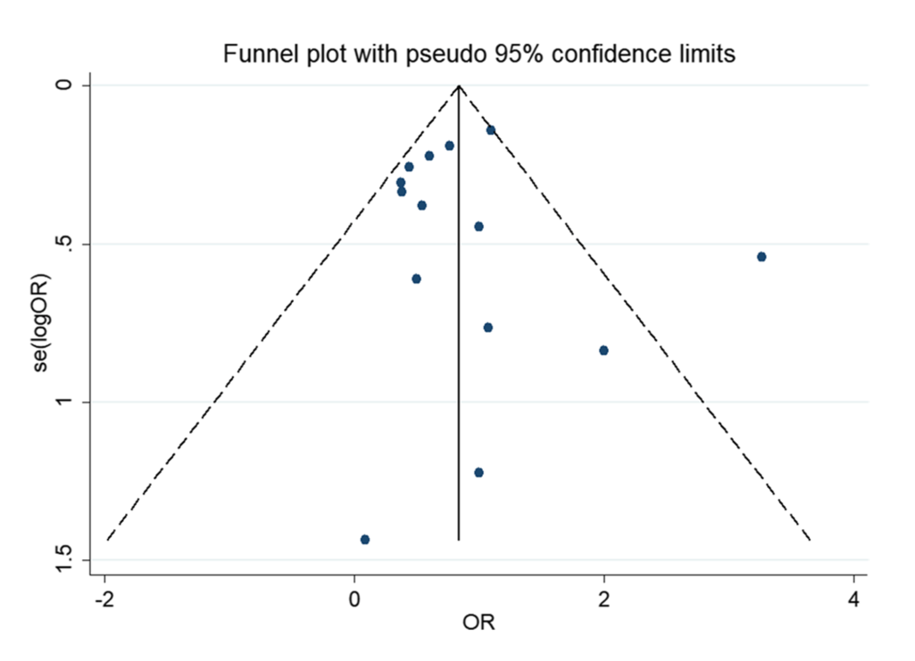
Random Effect Model
Relative symmetry
Begg’s test: P-value of 0.324
Egger’s test: P-value of 0.787

Slide 29
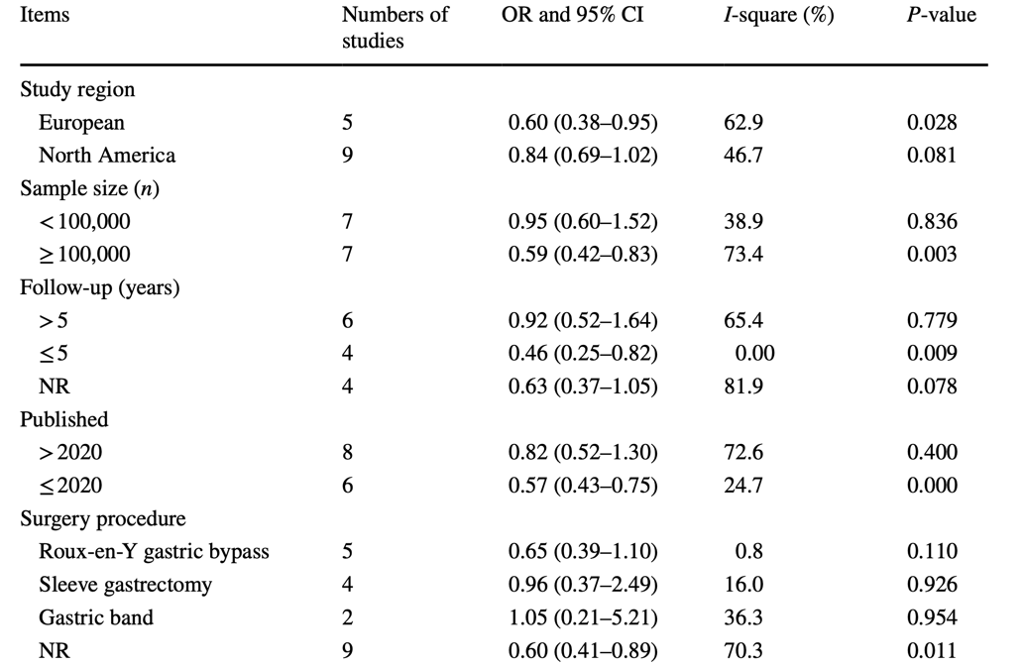
Sub-group analysis results

Slide 30
Data on gastric cancer after bariatric surgery
The estimated incidence of new cases of stomach cancer in the general population was 7.2 per 100.000.
Scozzari in 2013 identified 22 cases of gastric cancer in patients who underwent bariatric surgery.
Musella updated this study in 2019, and 10 more cases were identified in the literature
Lazzati found an incidence rate of 3.3 in the bariatric surgery group and 4.6 in the control group
None of thes present studies could establish the incidence of gastric cancer in bariatric surgery recipients

Slide 31
Limitations of the presented studies
Retrospective studies
Histological type and site of cancer not reported
Study population young
Few studies analyze the incidence based on different types of MBS
Not matched smoking, drinking status, diabetes, sex
Duration of follow-up (< 10 yrs)
Eradication of H. pylori infection

Slide 32
Conclusions
Seems confirmed the reduction of risk of EAC after MBS
Complex interactions between obesity and EAC
Further research is needed to explore the specific mechanisms underlying the intricate interplay between obesity, obesity surgery and EAC

Slide 33
Thank you for your attention

